Slide 1
Basic JavaScript
MIS 321

Slide 2
Introduction to Basic JavaScript
What is JavaScript?
A programming language that makes web pages interactive
JavaScript vs. Java
JavaScript is designed to integrate into HTML
Java is an object-oriented language

Slide 3
JavaScript Data types
Like C#, JavaScript has primitive data types:
String, Boolean, Integer, Floating Point, Null, Void
Key word var is used for variables in JS:
var variable_name = value

Slide 4
Decision Making & Control Structures
Similar capabilities as the languages we have seen:
IF, IF-ELSE, IF-ELSE IF, SWITCH, WHILE, DO, FOR
if (condition)
{
statements if condition is TRUE;
}
Else
{
statements if condition is FALSE;
}
switch (expression or variable name) {
case label:
statements if expression matches this label;
break;
case label:
statements if expression matches this label;
break;
default:
statements if expression does not match any label;
break;
}

Slide 5
Loops
Similar capabilities as the languages we have seen:
DO, DO/WHILE, FOR
For (initialize; conditional test; increment/decrement)
{
Statements to execute;
}
while (condition)
{
Statements; Increment/decrement;
}

Slide 6
Objects
JavaScript contains built-in objects and allows the user to create custom objects.
Creating Objects: Use the new constructor
var X = new Array()
Examples:
date, time, math, strings, arrays

Slide 7
Functions
A pre-written block of code that performs a specific task. Some functions return values; others perform a task like sorting but return no value.
There may or may not be an argument or parameter in the parenthesis, but the parenthesis must be there.
function name_of_function (arguments)
{
statements to execute when function is called;
}

Slide 8
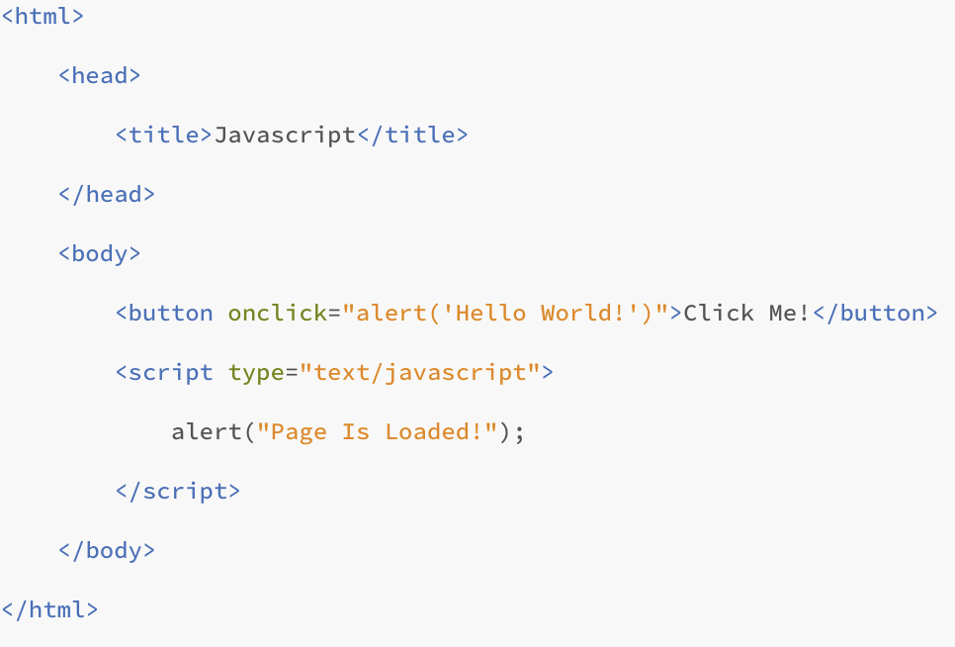
JavaScript & HTML
JavaScript can be used inside HTML as an internal script
Tag <script type=“text/javascript”> to indicate

Slide 9
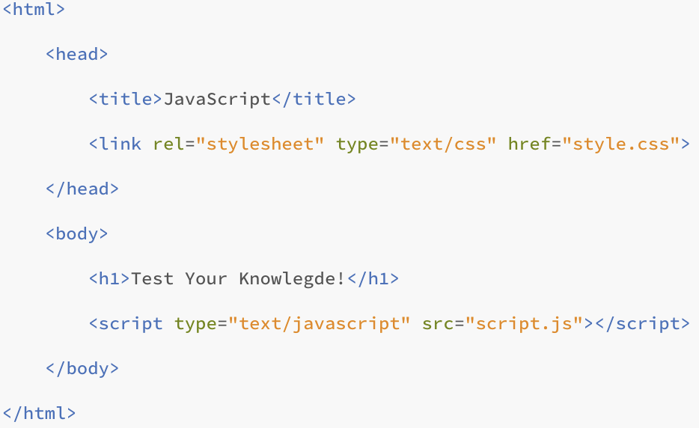
JavaScript & HTML
If you use a separate JavaScript file, you must have a reference to your file in the HTML

Slide 10
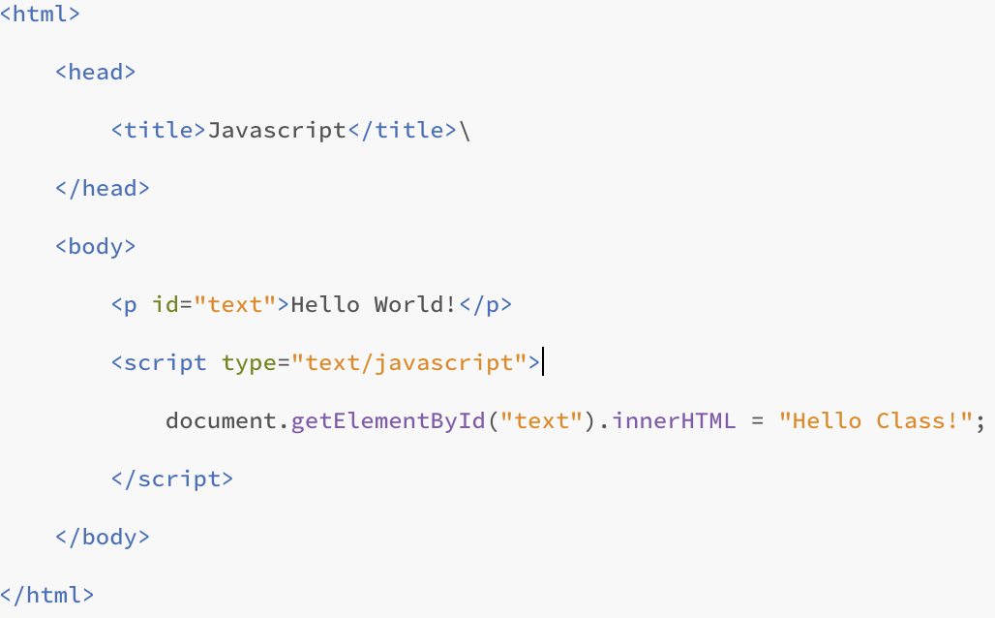
JavaScript & HTML
You can access and change elements of HTML with JavaScript

Slide 11
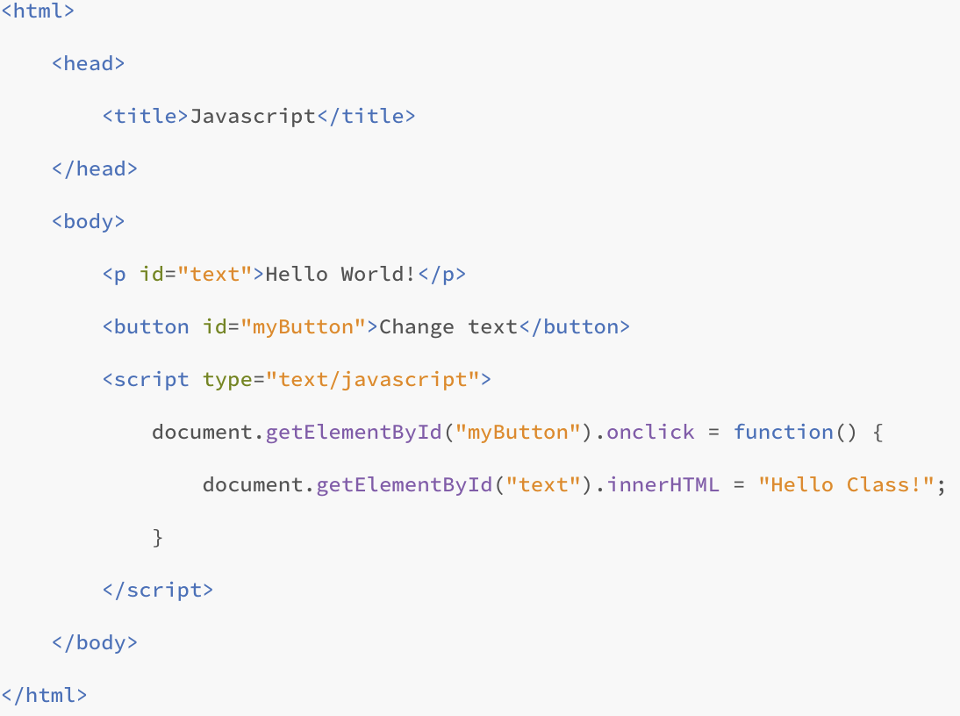
JavaScript & HTML
You can make changes based on web user’s interactions with page

Slide 12
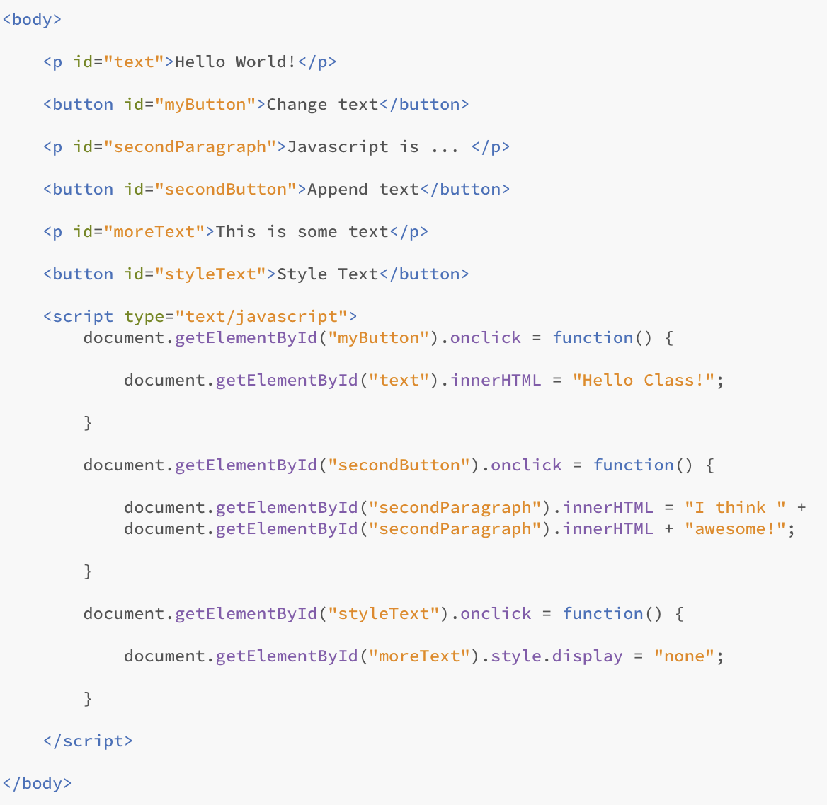
JavaScript & HTML
Notes:
Another example for how you can change text in HTML using JavaScript

Slide 13
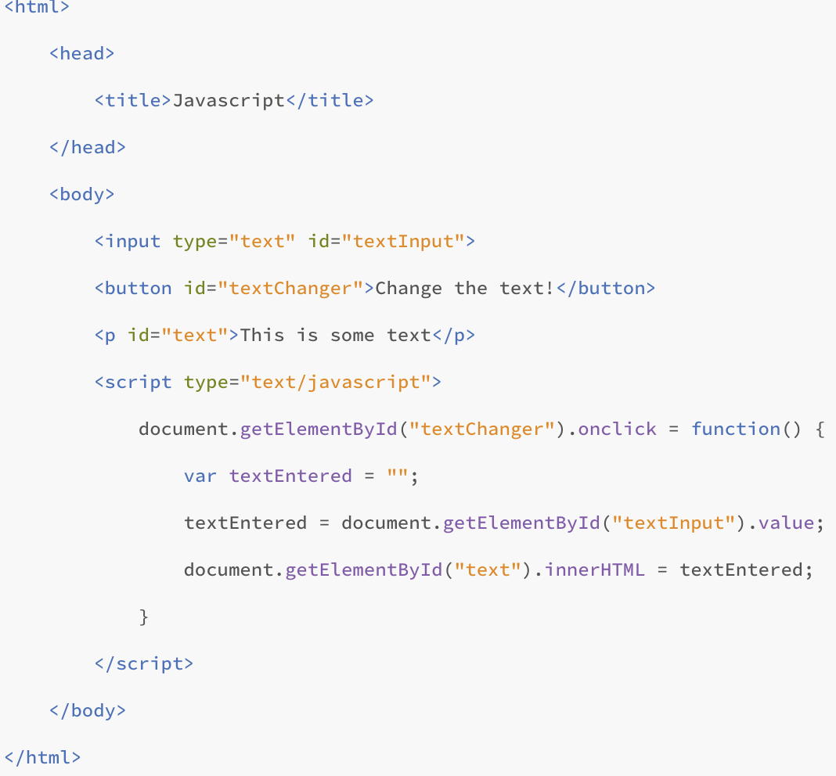
JavaScript & HTML
Notes:
An example for how you can use variables to hold data

Slide 14
Helpful Resources
https://www.w3schools.com/js/default.asp
https://ualearn.blackboard.com/bbcswebdav/pid-5740154-dt-content-rid-56596946_1/courses/45620.202040/Javascript%20Reference.pdf

Slide 15
Questions?

